Slide 1
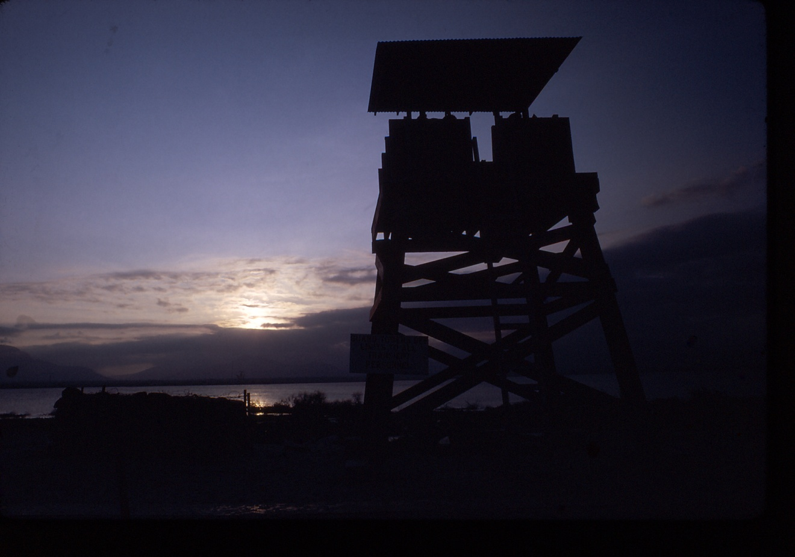
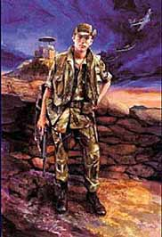
633RD Security Police Squadron
Pleiku Air Base Vietnam
Notes:
Good Morning for the next hour I will take you back to the Vietnam War and describe the 633rd Security Police Squadron’s roll in defending Pleiku Air Bases in Vietnam.
First we’ll look at a brief history of how base defense evolved in the war.
Then a description of the Central Highlands, Pleiku City, the area surrounding Pleiku Air Base and then the Base itself.
We’ll look at the 633rd s evolution from 1965 through 1969 and beyond
I will describe to you what it was like during the 1968 Tet Offense attack on Pleiku Air Base as seen through the eyes of the men that were there.
I will summarize the attacks leveled at Pleiku Air Base through out the Vietnam War.
And finally describe the brotherhood between all the security police that served in Vietnam
I hope you’ll enjoy seeing this brief glimpse of the heritage of todays Security Forces.

Slide 2
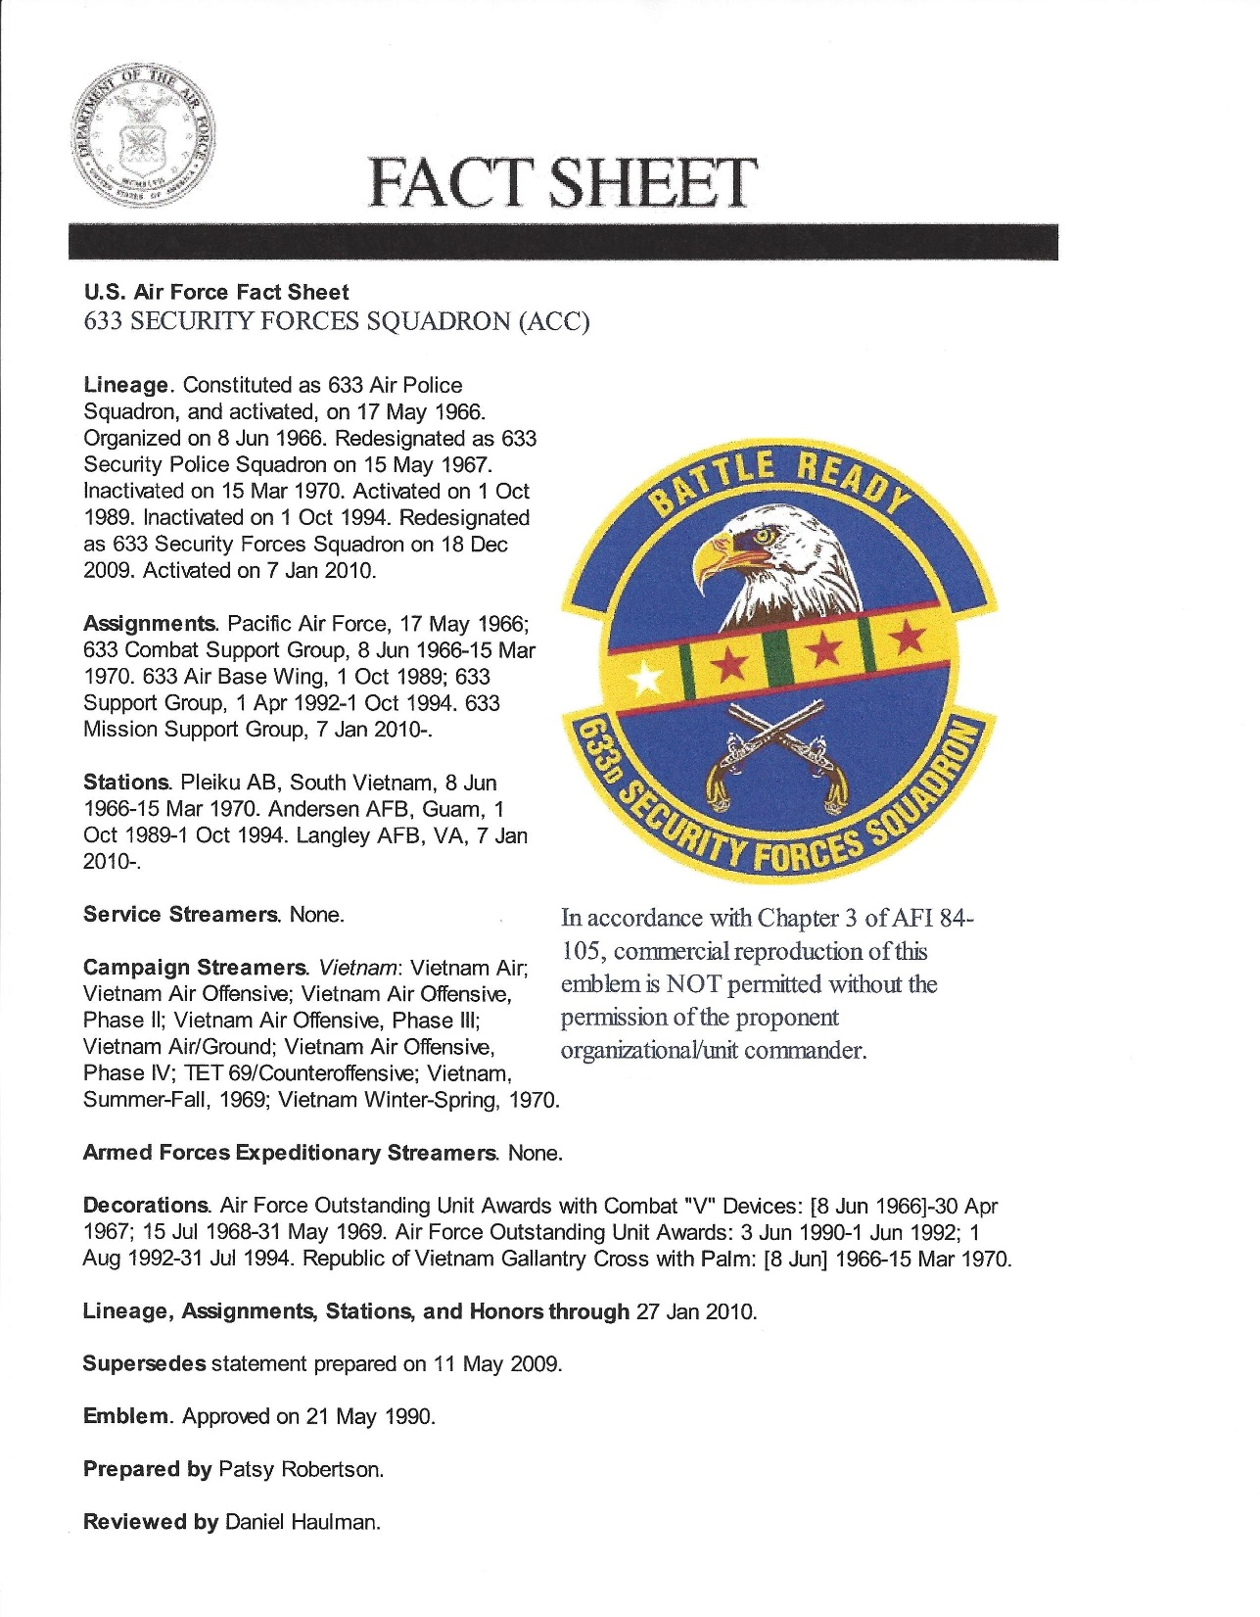
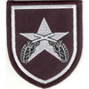

Slide 3
633rd Security Police Squadron
Mission
Security Police mission was to prevent close-in enemy reconnaissance, infiltration, raids, ambushes, and attacks by sapper forces. The mission concept called for 3 zone development of security forces in sectors: Preventative perimeter, Secondary defense and Close-in defense. The preventative perimeter-traced the base boundary line and was the first line of defense to detect, report, and engage the enemy. It consisted of: K-9 patrols, Antipersonnel mines, trip flares, concertina wire, observation towers, and manned automatic weapons emplacements. Secondary zone-separated the preventative perimeter from operational resources. This zone consisted of security alert teams and reaction forces. Close-in defense positioned entry control points and positions within areas harboring operational resources, to guard against sappers and saboteurs. The nerve center of all security was the Central Security Control which provided command and control of security forces, communications within security zones and external units in the Pleiku area, and plotted enemy positions and movement.

Slide 4
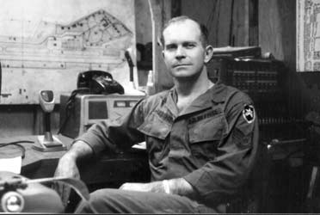
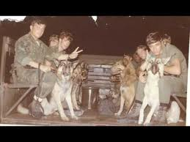
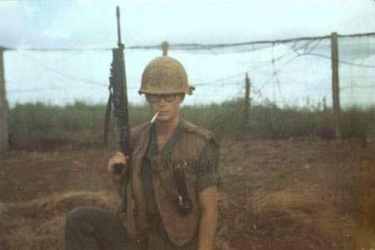
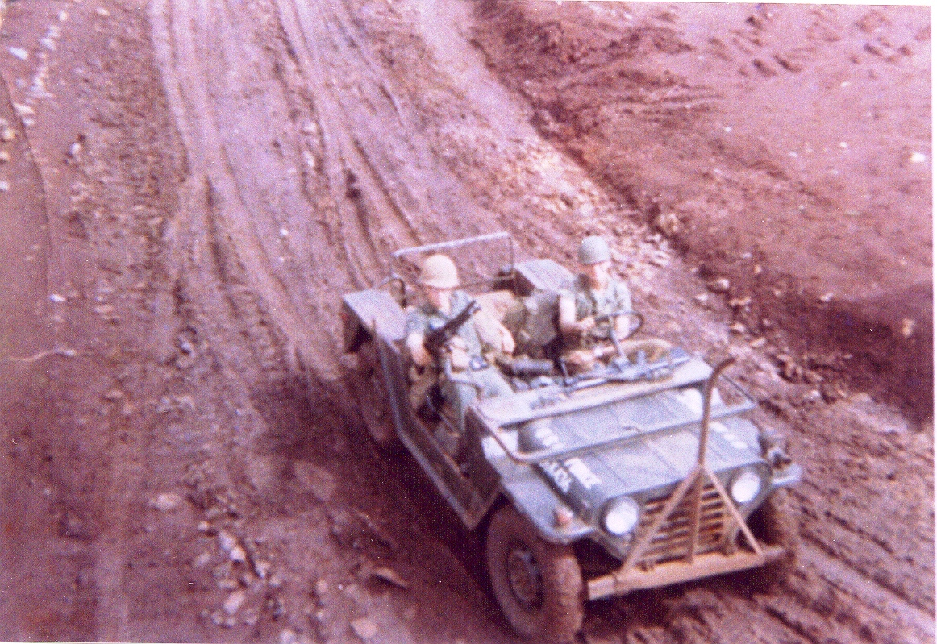
K-9 Posting
Central Security Control
Perimeter Post
Security Alert Team

Slide 5
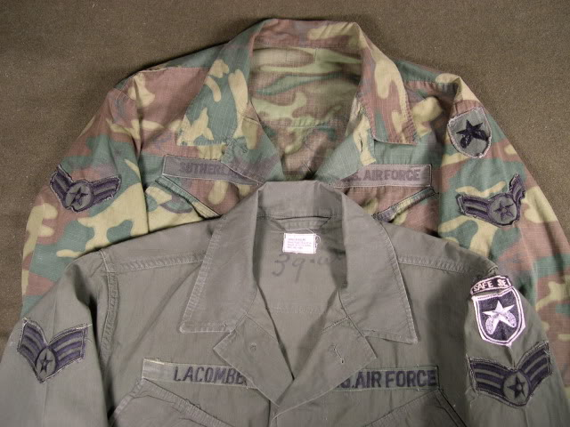
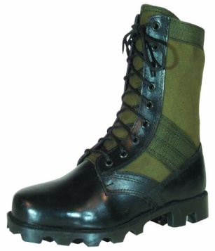
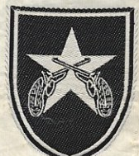
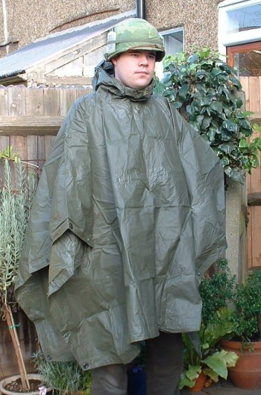
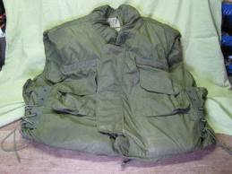
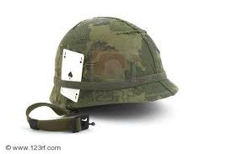
Security Police Uniform
And Patch

Slide 6
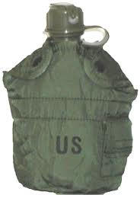
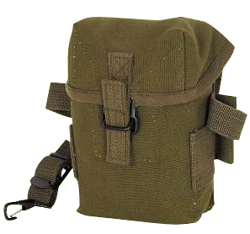
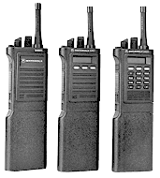
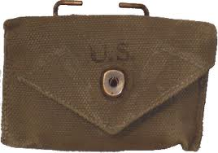
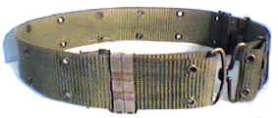
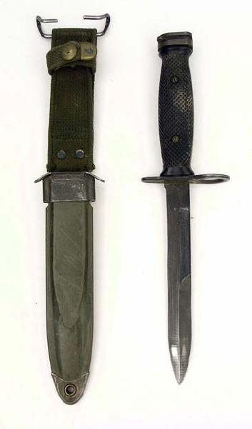
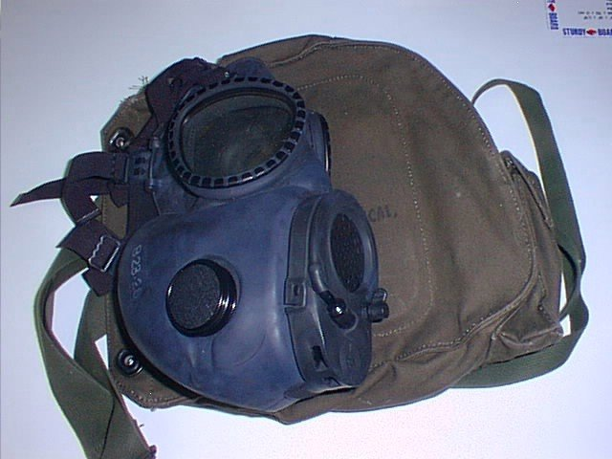
Security Police Equipment

Slide 7
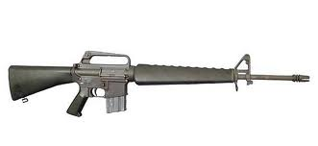
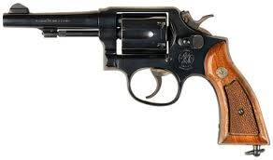
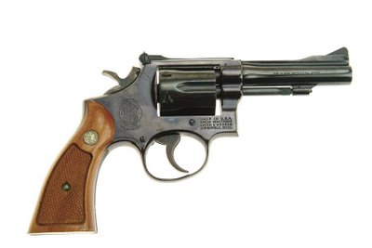
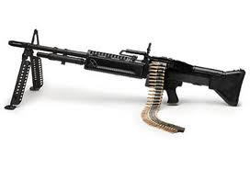
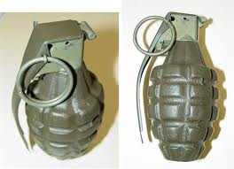
S&W
Model 10
M16
S&W
Model 15
XM 148
M60
M79
MK2

Slide 8
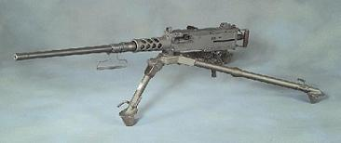
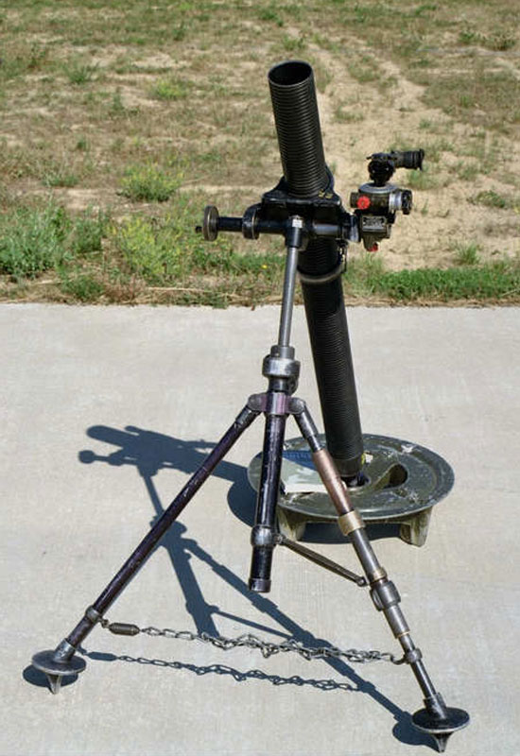
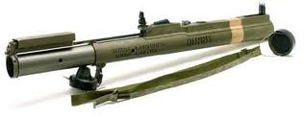
M2
50 cal
M29
81mm
M72
66mm

Slide 9
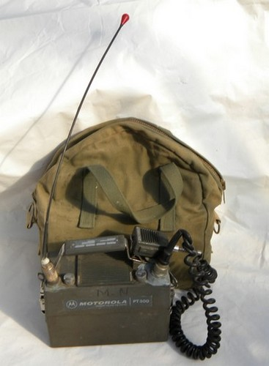
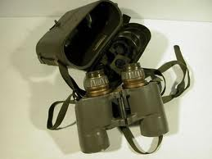
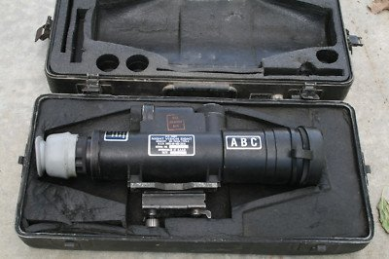
Security Police Equipment
Night Vision (Starlight Scope)

Slide 10
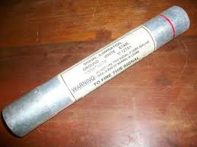
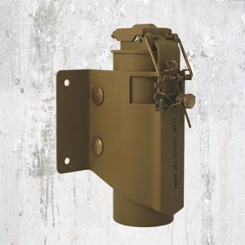
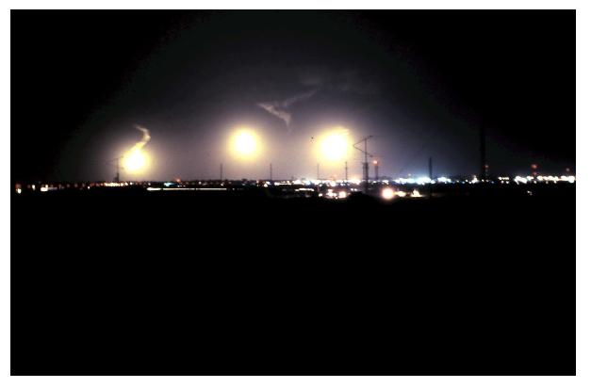
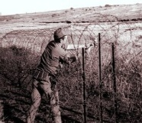
Hand Slap Flare
Trip Flare
Air drop and artillery flares
A

Slide 11
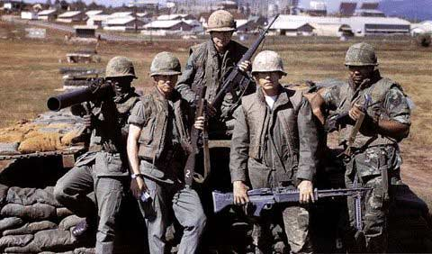
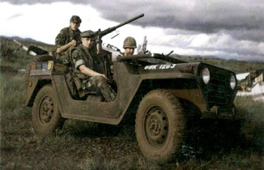
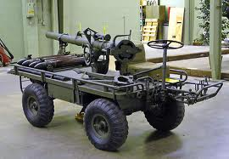
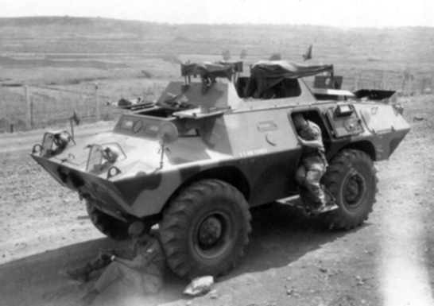
M-151 Jeep with M-2
50 Cal
822nd Combat Security Police
M40 Recoilless Rifle
M706 Armored
Personnel carrier

Slide 12
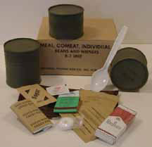
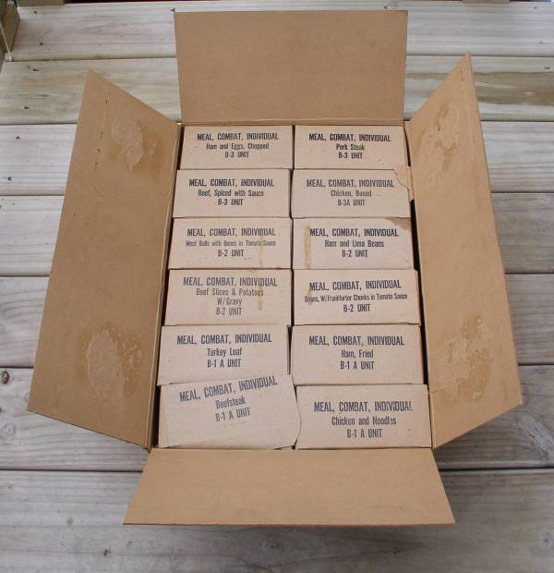
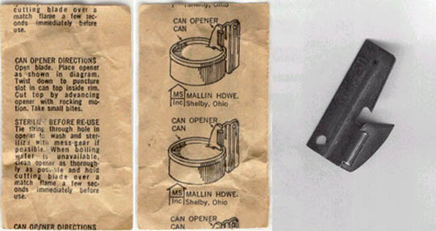
On duty meals (C Rations)

Slide 13
VC/NVA ATTACKS ON PLEIKU AIR BASE
1966-1972
ATTACKS AIRCRAFT LOSES WIA/KIA
40/395RDS 6DES/70DAM 52/9
Attacks where comprised mostly of sand-off attacks
with 122mm rockets and 82mm mortar.
There were some that included both stand-off and
sapper and sapper alone.

